Slide 1
SFWE 301 Pharmacy Management System (PMS) Acceptance Test Review
SFWE 301 - FALL 2024
TEAM 9:
Moamin Sami, Chase Hughes, William Young, Jaymz Wallen

Slide 2
Entrance Criteria
Baselined requirements available
SVRM completed and up to date
Test procedures completed and executed with no notable defects
Completed traceability between system requirements, SFWE requirements, validations, and change requests
Canned data completed and accurately represents the system data
Test environment setup completed with applicable test case data available
acceptance test completed
any defects reported should either be fixed and tested, or a risk assessment should be performed and completed
Anomalies analyzed and impact assessment completed

Slide 3
PMS Description
The Pharmacy Management System (PMS) is a comprehensive software solution designed to streamline and automate various operations within a pharmacy such as efficient inventory management, prescription processing, and sales tracking, accurate dispensing of medications, manages patient records and provides inventory control capabilities to pharmacy managers.
The PMS enhances overall customer service and safety, while providing an easy to use system for all pharmacy personnel. Additionally, it supports billing, reporting, and regulatory compliance, making it an essential tool for improving operational efficiency and reducing errors in a pharmacy setting.

Slide 4
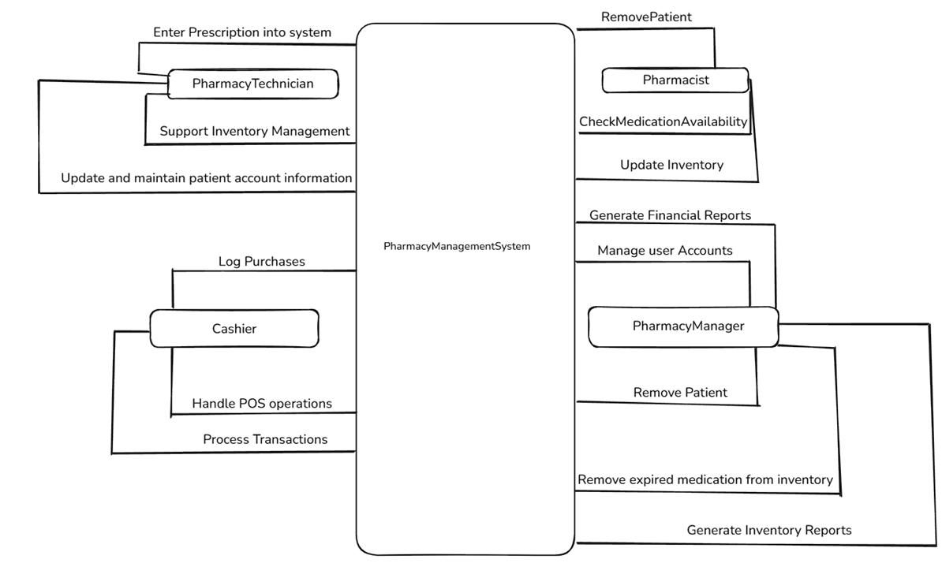
PMS Diagrams - Context Diagram
Context Diagram

Slide 5
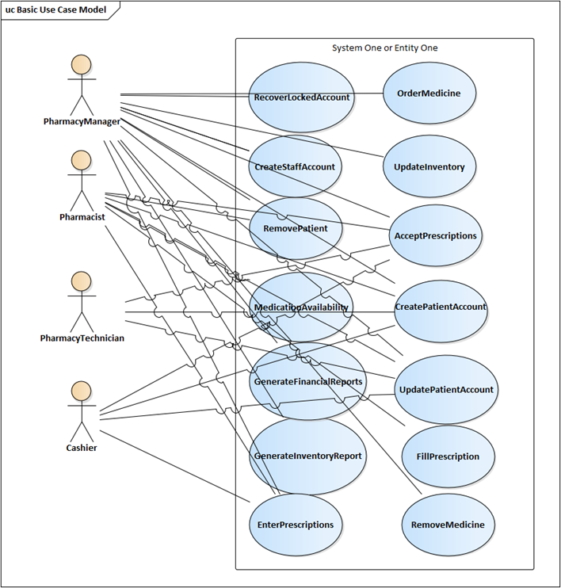
PMS Diagrams -
Use Case Diagram

Slide 6
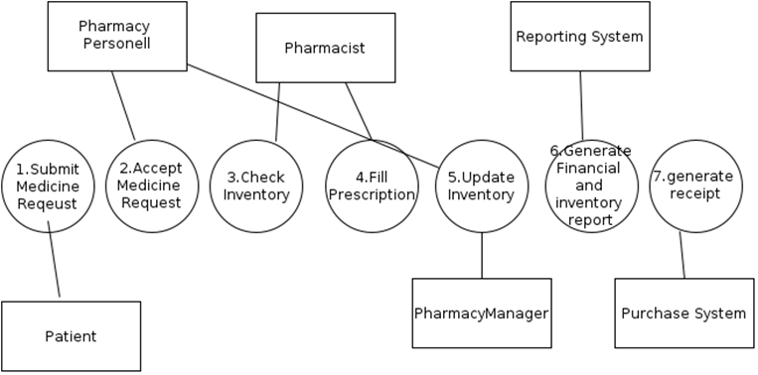
PMS Diagrams - Data Flow Diagram

Slide 7
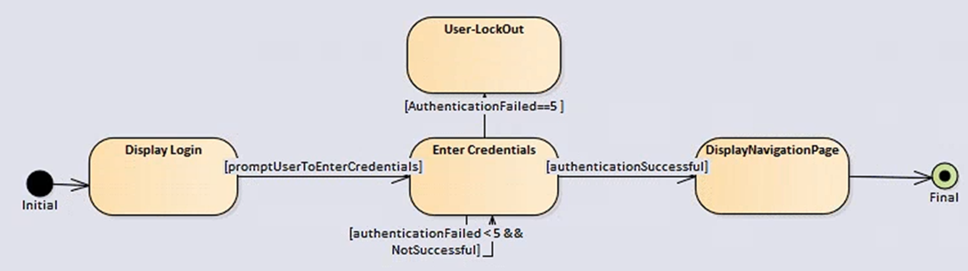
PMS Diagrams - State Machine Diagram

Slide 8
Summary of Final SW Requirements / SVRM
Categories:
Front End
Back End
Inventory Control
Prescription Processing
Inventory Control Requirements
Pharmacy Report Generation
Non-Functional

Slide 9
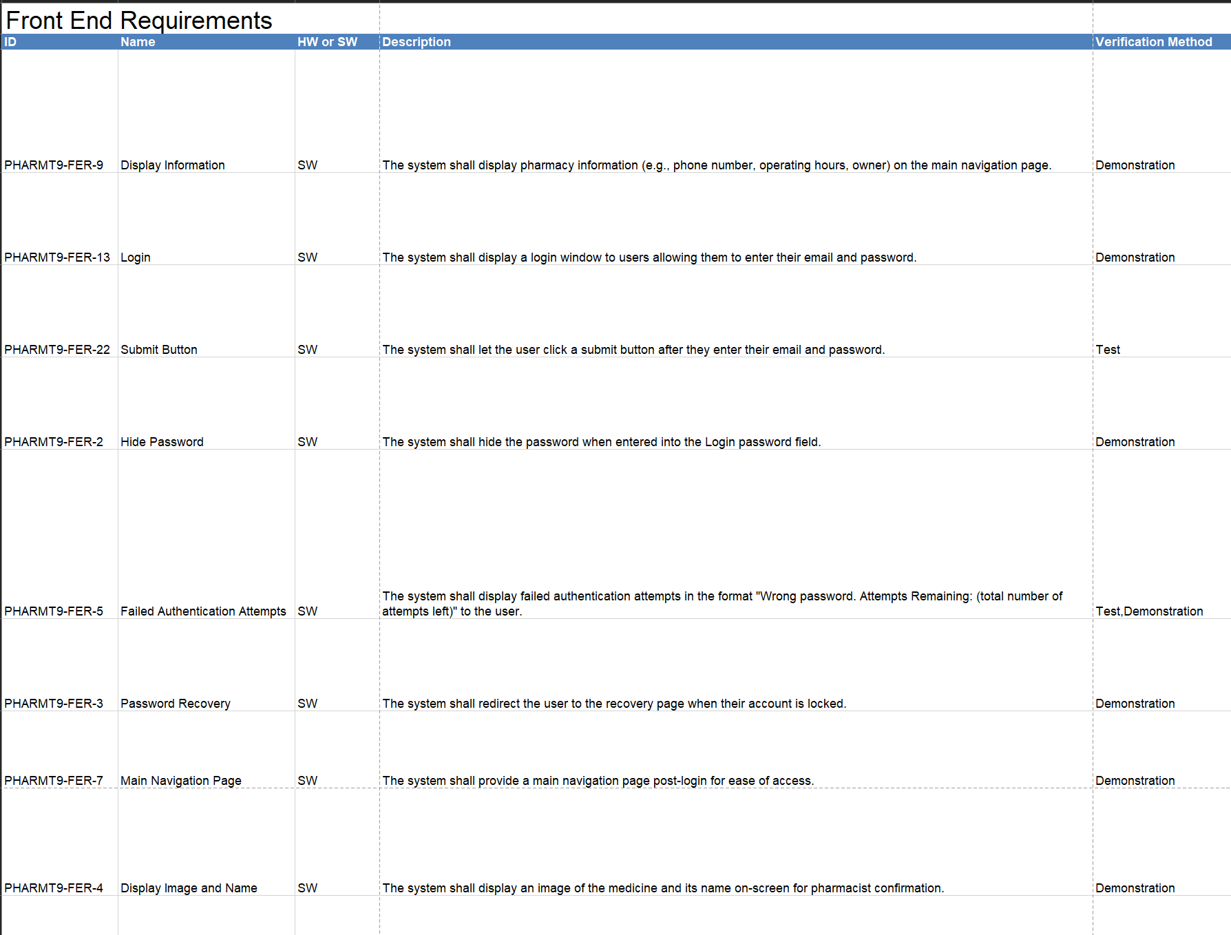
Front End Requirements

Slide 10
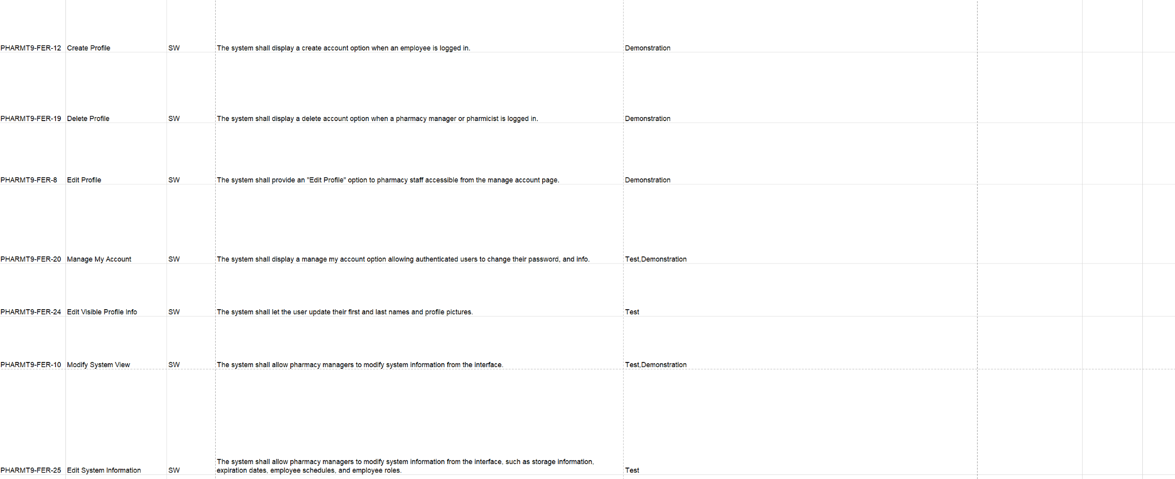
Front End Requirements

Slide 11
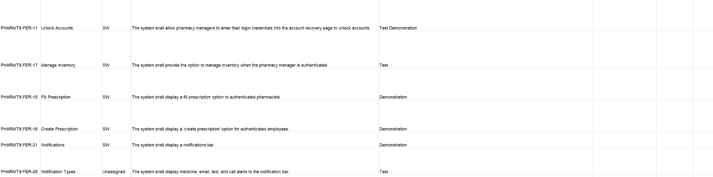
Front End Requirements

Slide 12
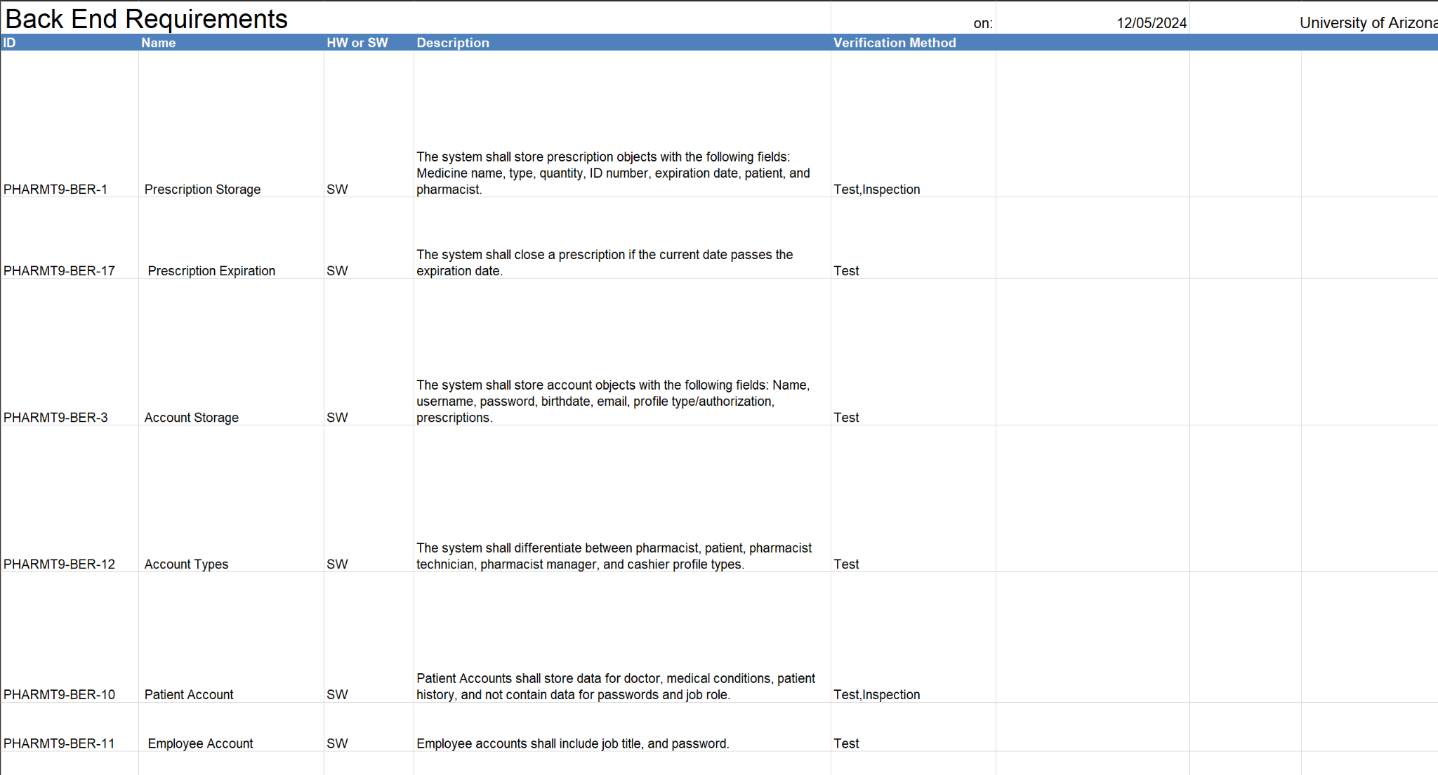
Back End Requirements

Slide 13
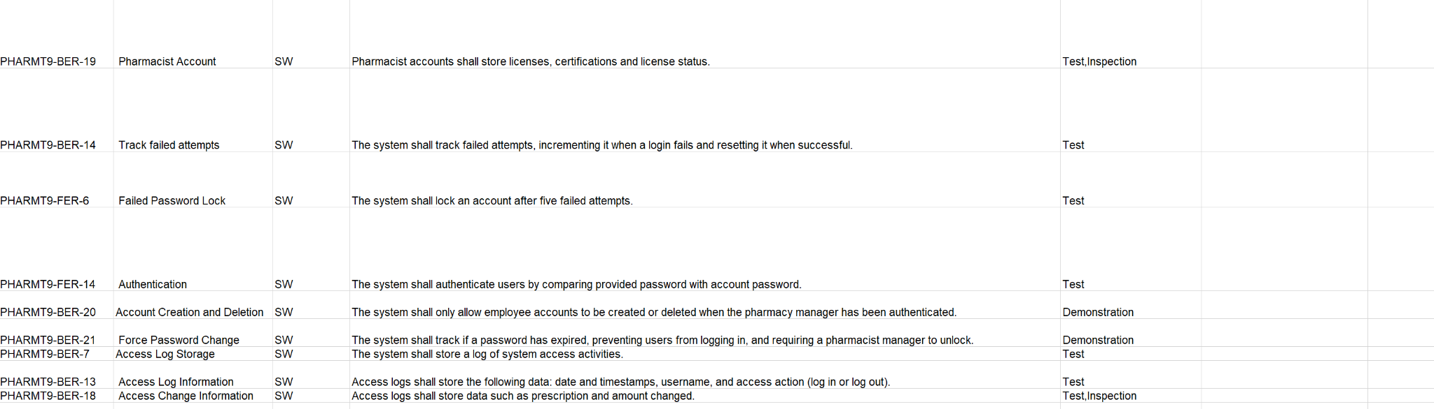
Back End Requirements

Slide 14
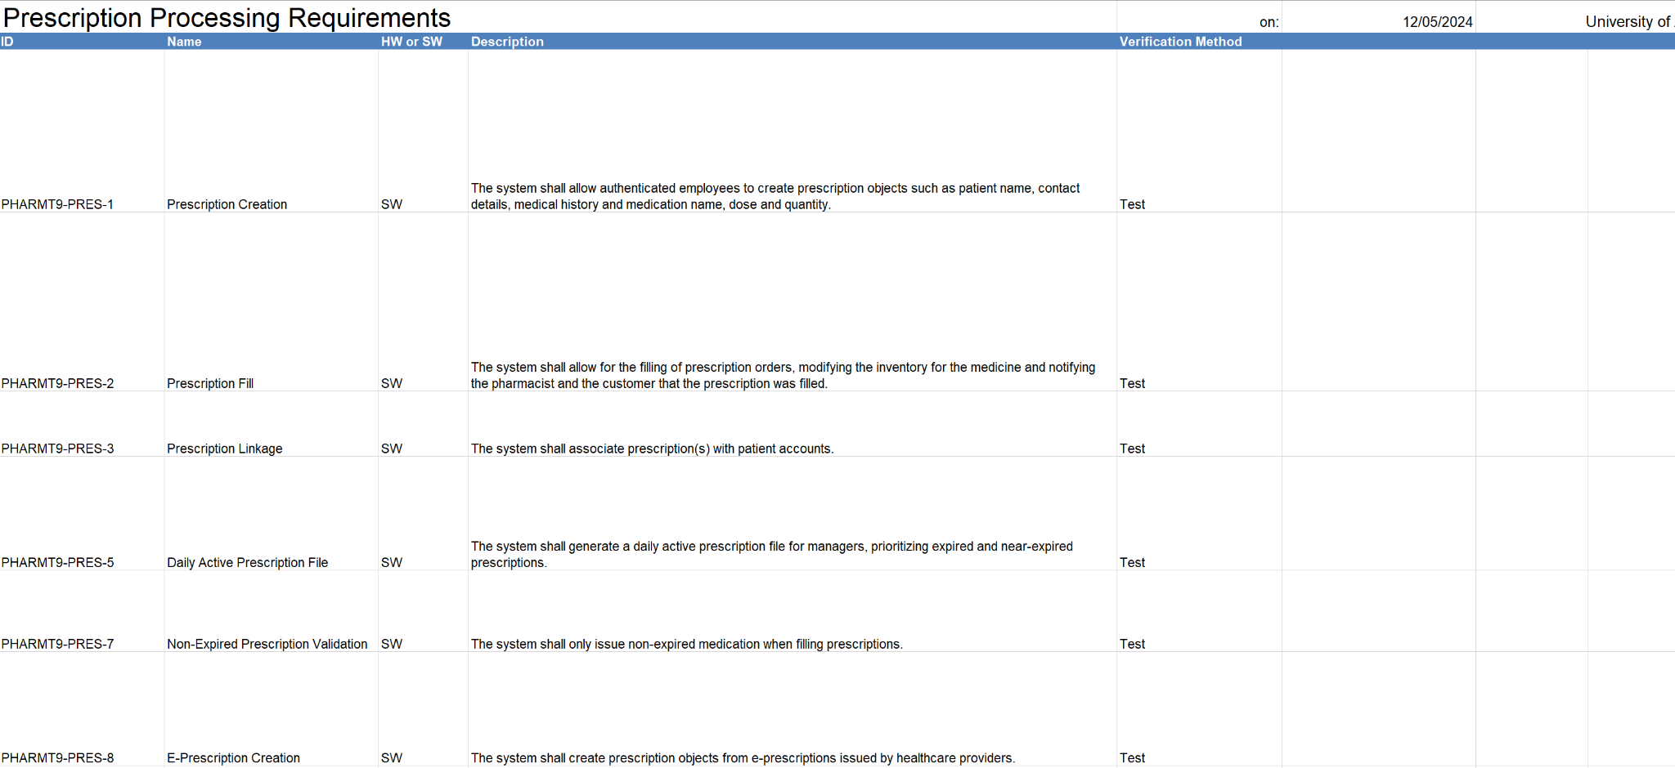
Prescription Processing Requirements

Slide 15
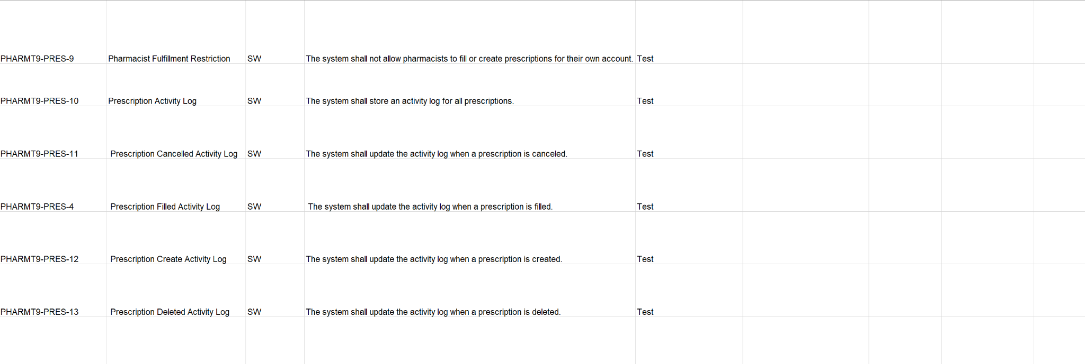
Prescription Processing Requirements

Slide 16
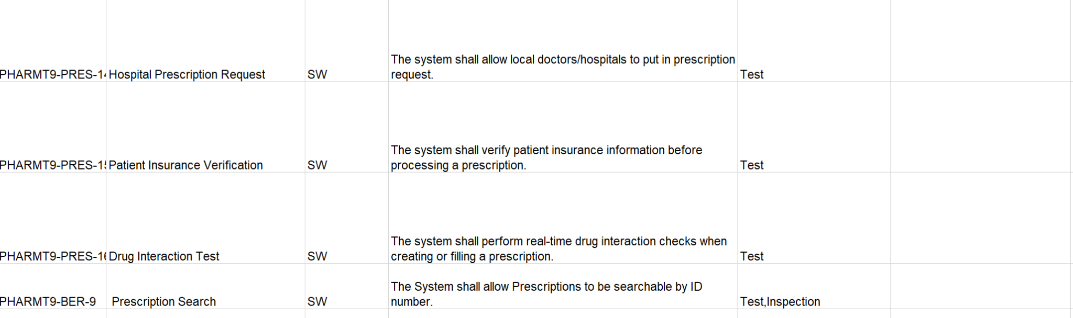
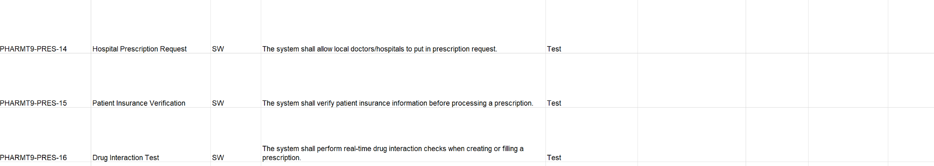
Prescription Processing Requirements

Slide 17
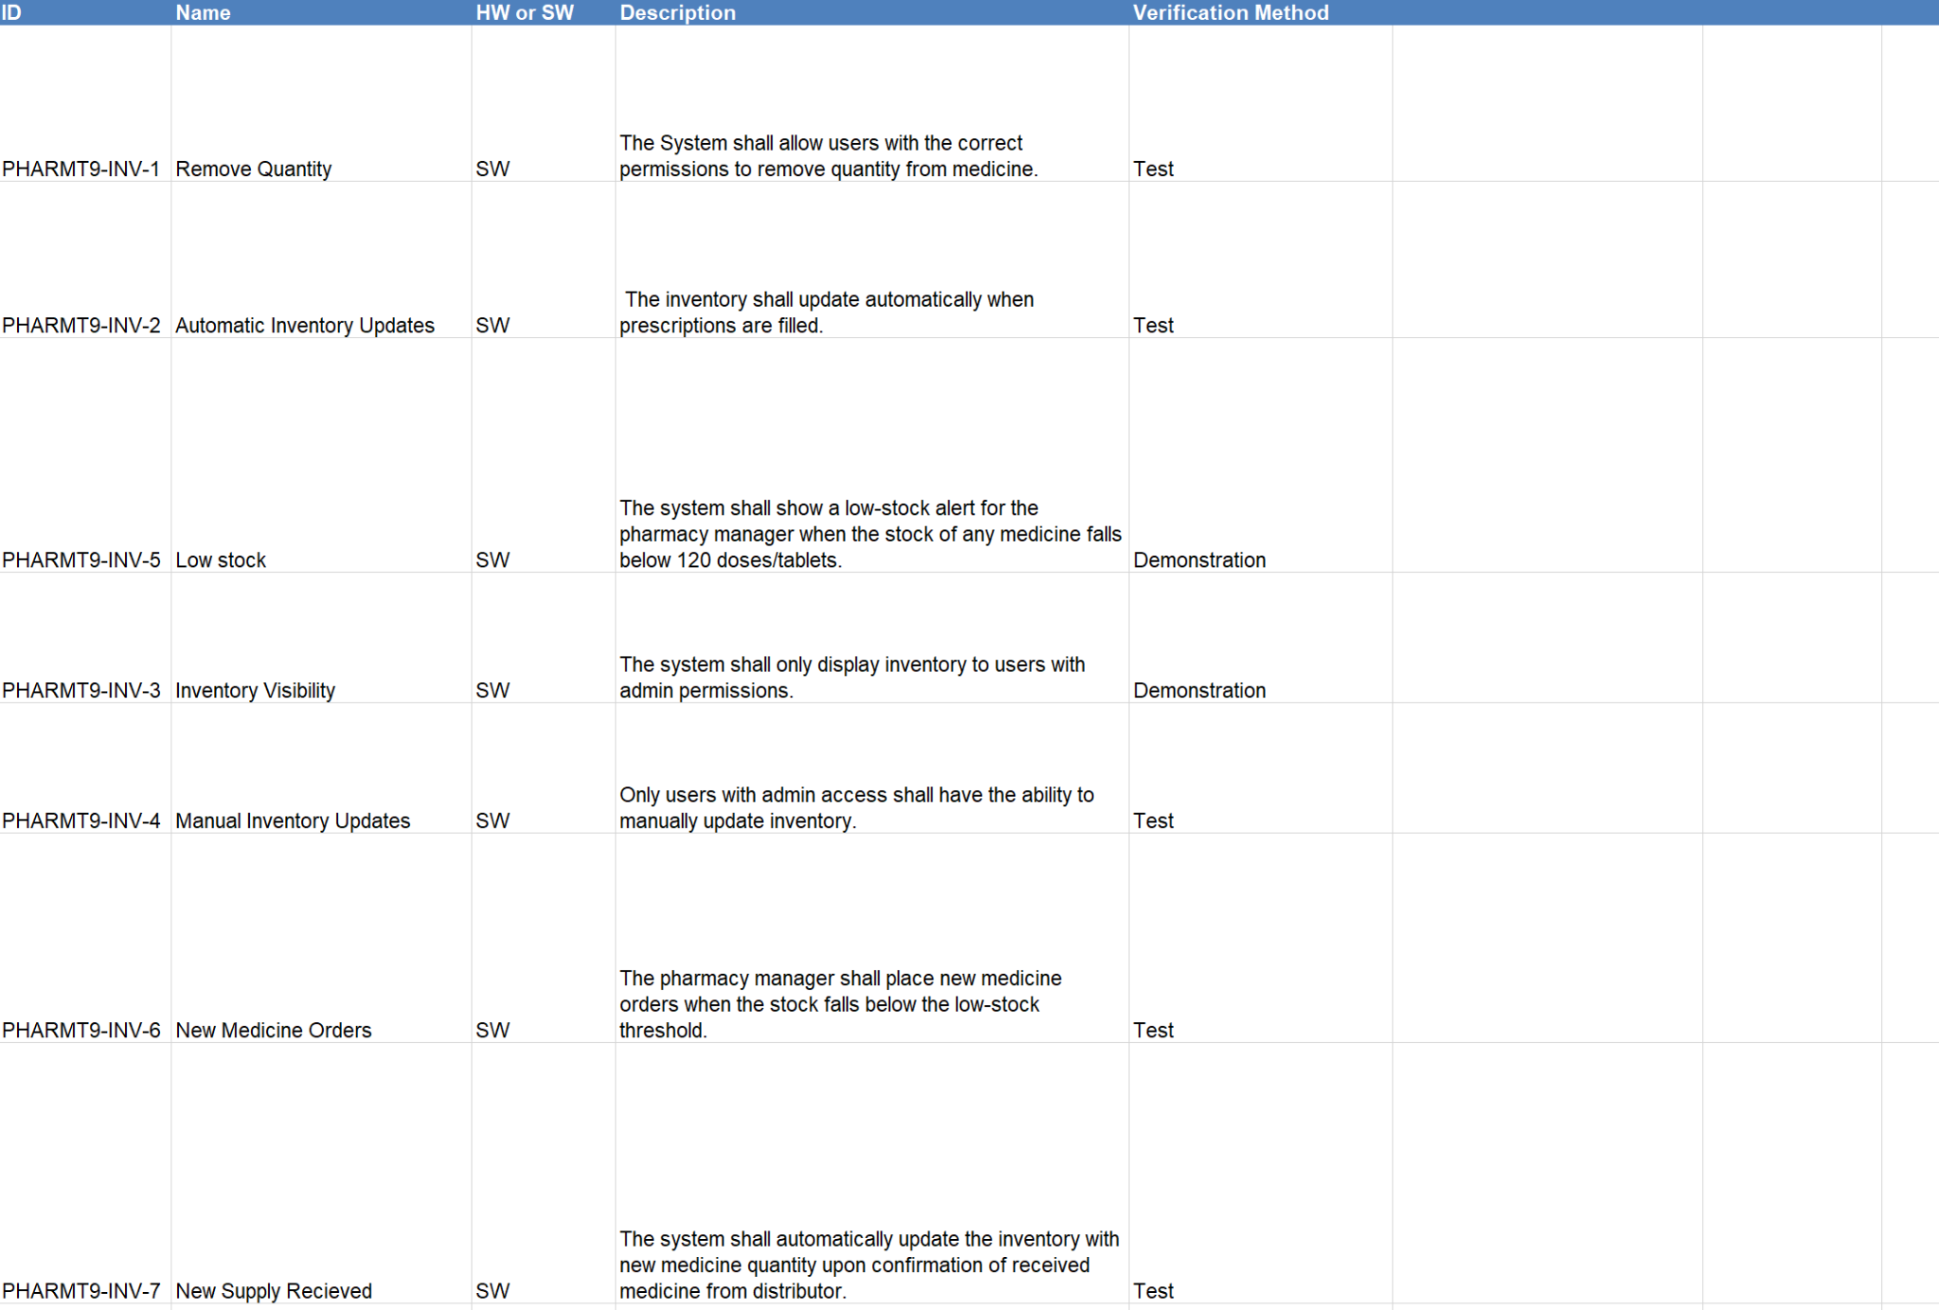
Inventory Control Requirements

Slide 18
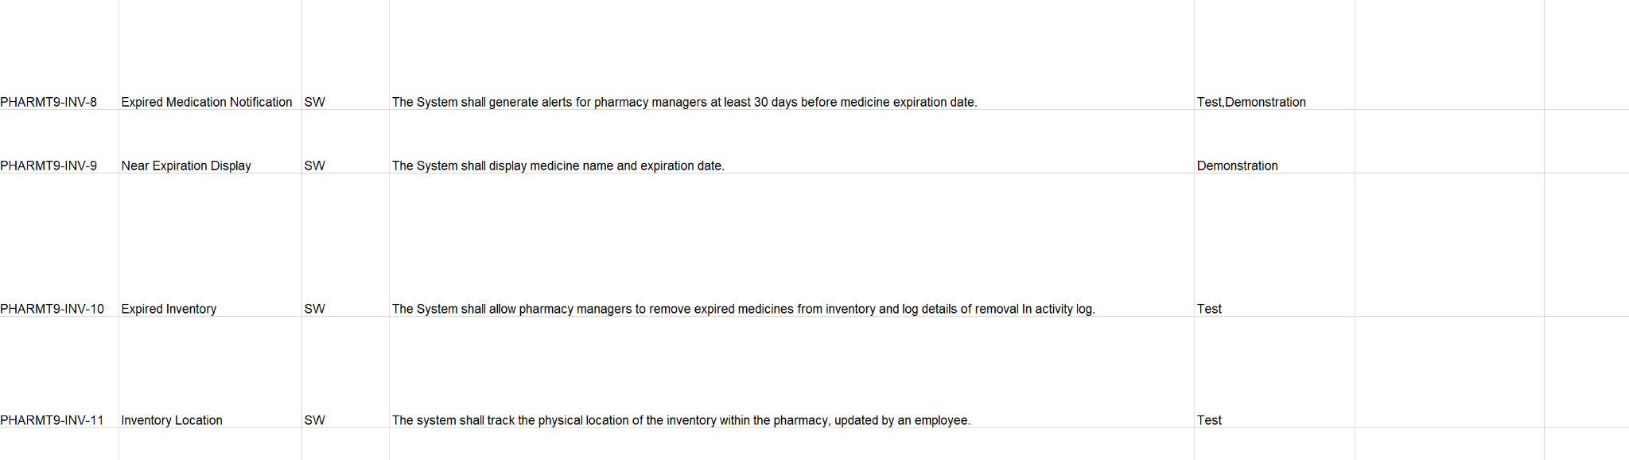
Inventory Control Requirements

Slide 19
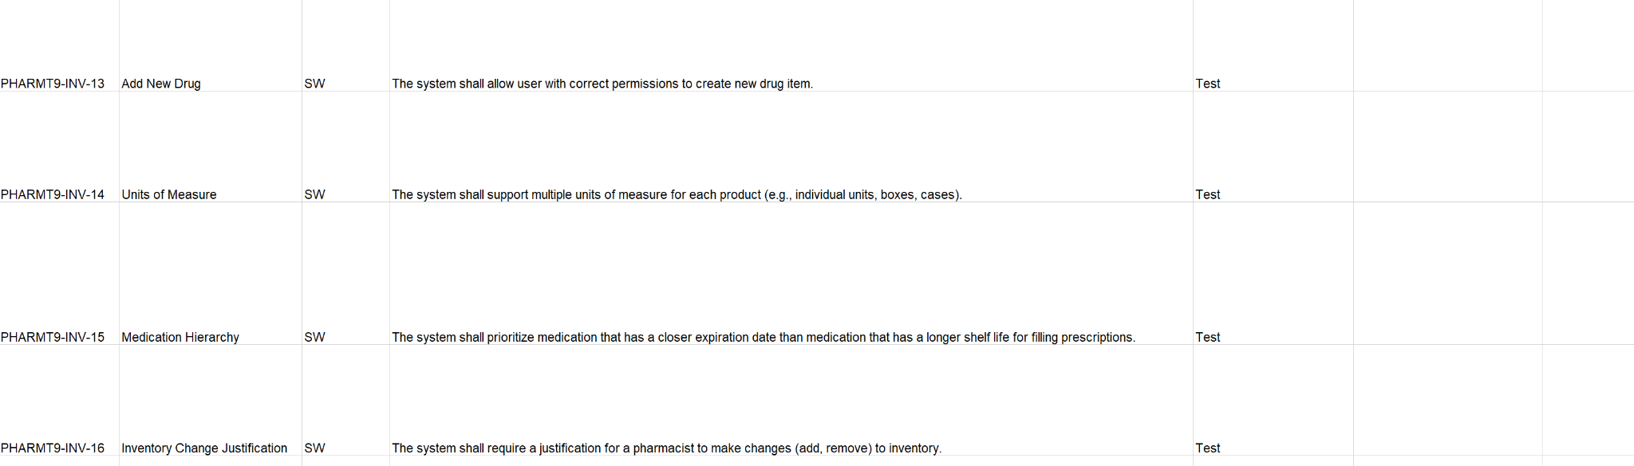
Inventory Control Requirements

Slide 20
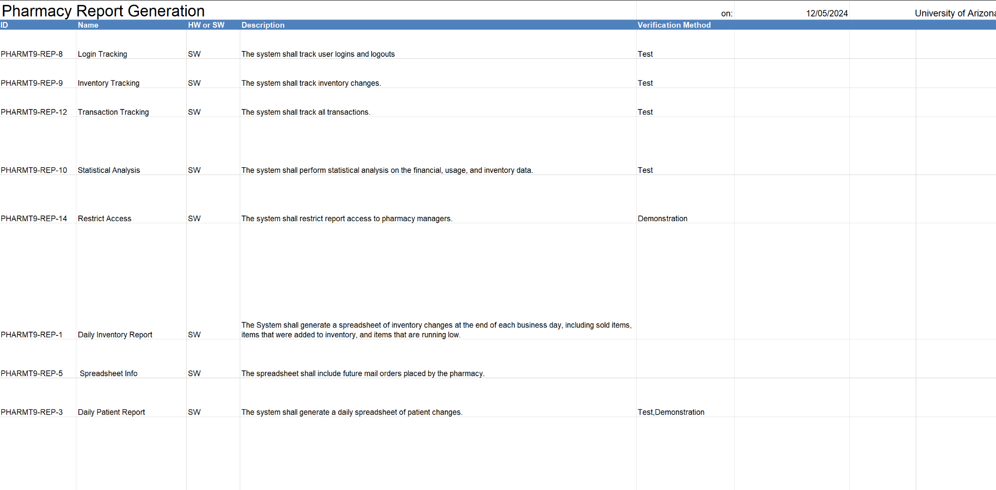
Pharmacy Report Requirements

Slide 21
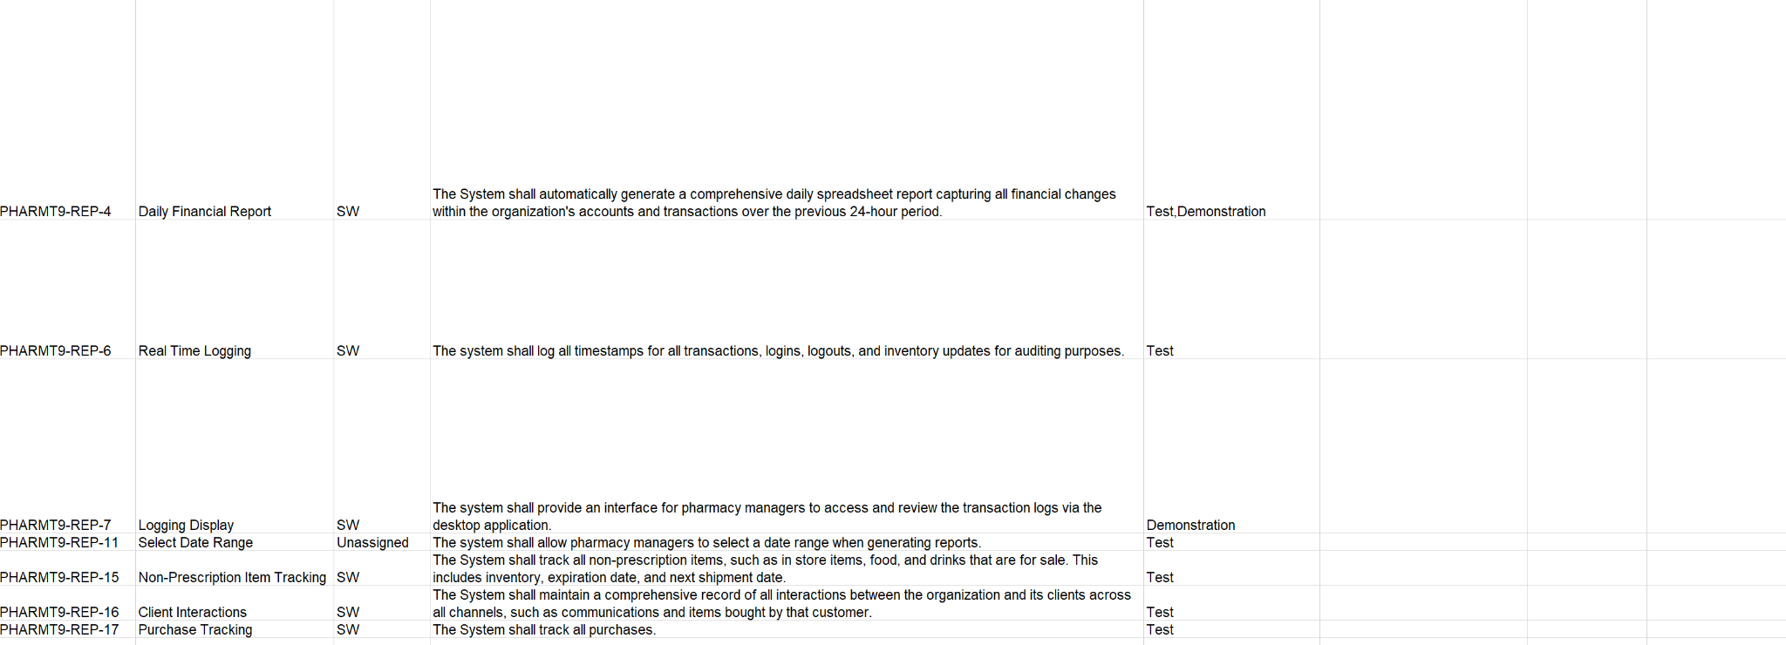
Pharmacy Report Requirements

Slide 22
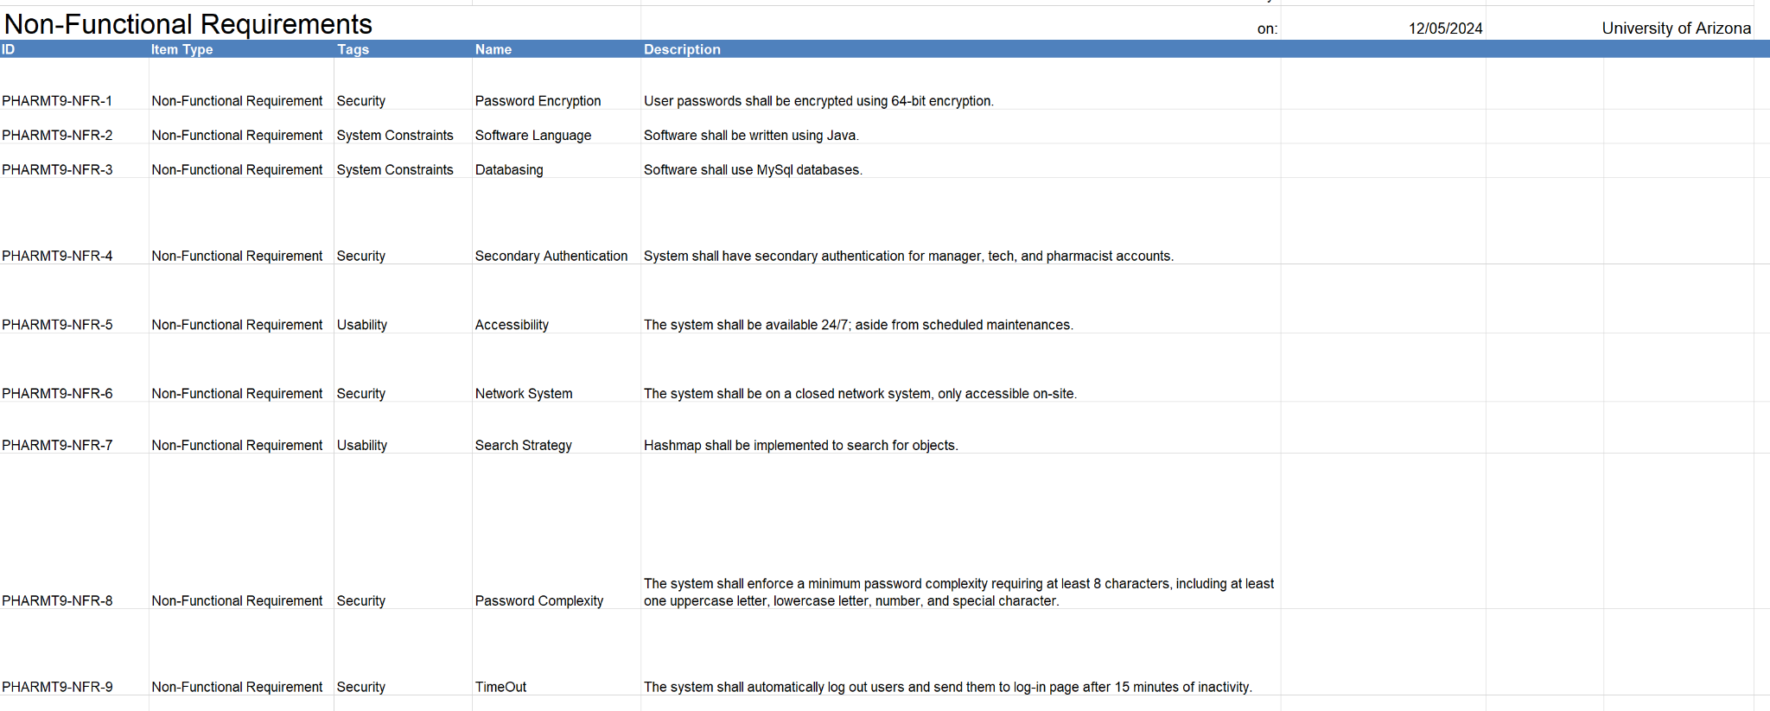
Non-Functional Requirements

Slide 23
Change Requests Summary
As the implementation of our system progressed, we realized that some of the original requirements were challenging to complete, which led to the need for change requests (CRs). These CRs were necessary to replace certain requirements with more relevant ones to ensure the system's functionality. The frequent change requests towards the end of the process were crucial for adapting the requirements to align with the actual system implementation. Some requirements were moved from the back-end system to better integrate with the inventory control subsystem. Each CR was linked to the specific requirement it referenced for improved traceability, ensuring that the system met the intended objectives and could function properly.

Slide 24
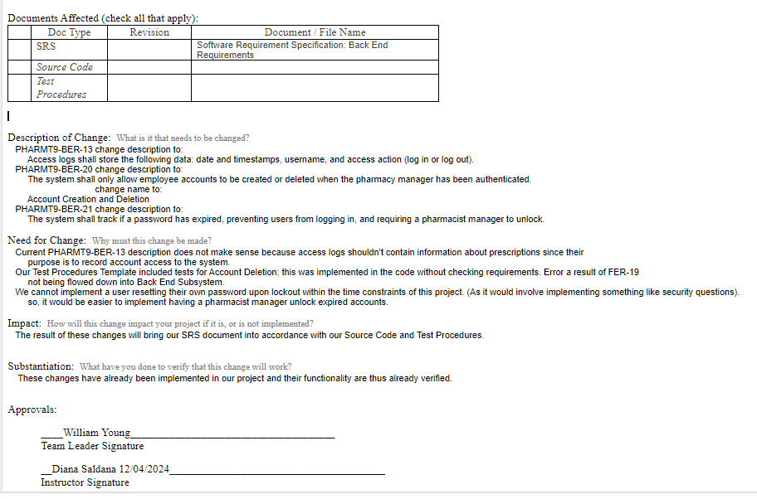
Change Request - Back End Subsystem
Back End Change Request
Changed requirement requiring unnecessary information in access logs to include only date, username, and action.
Added account deletion by Pharmacy Managers since it was not flowed into BER from FER
Replaced user self service password resets with Pharmacy Manager performed account unlocks, since this would be too complicated to implement within our constraints

Slide 25
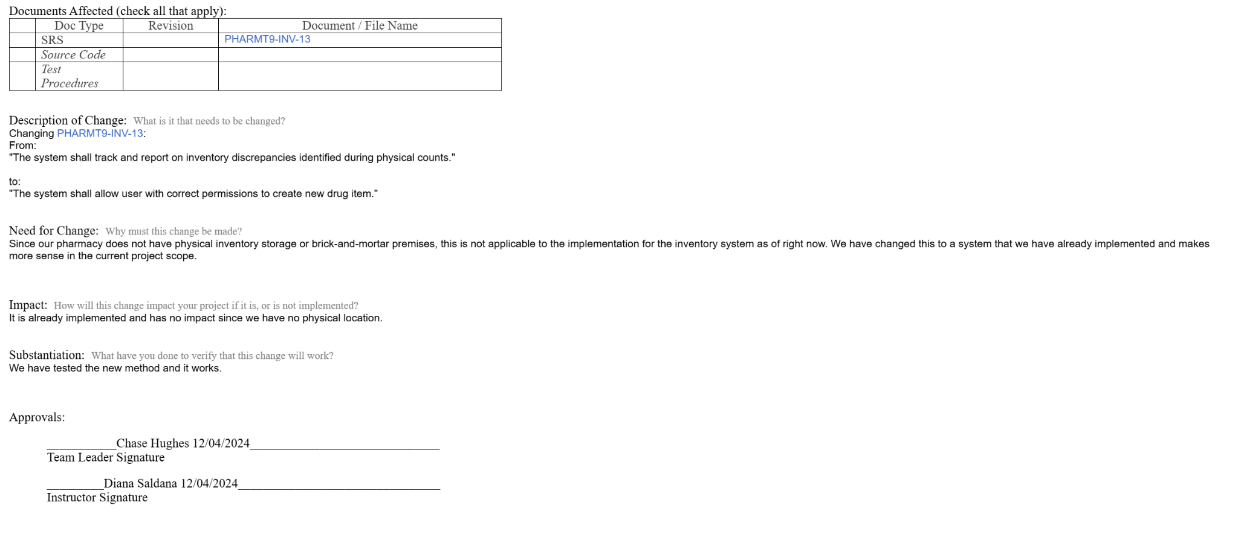

Inventory Discrepancies Change Request
We made one change to this requirement. We changed it from tracking discrepancies in the physical location to allowing a user to create a new drug item. We did this because we cannot implement a physical location change but had implemented adding the new drug

Slide 26
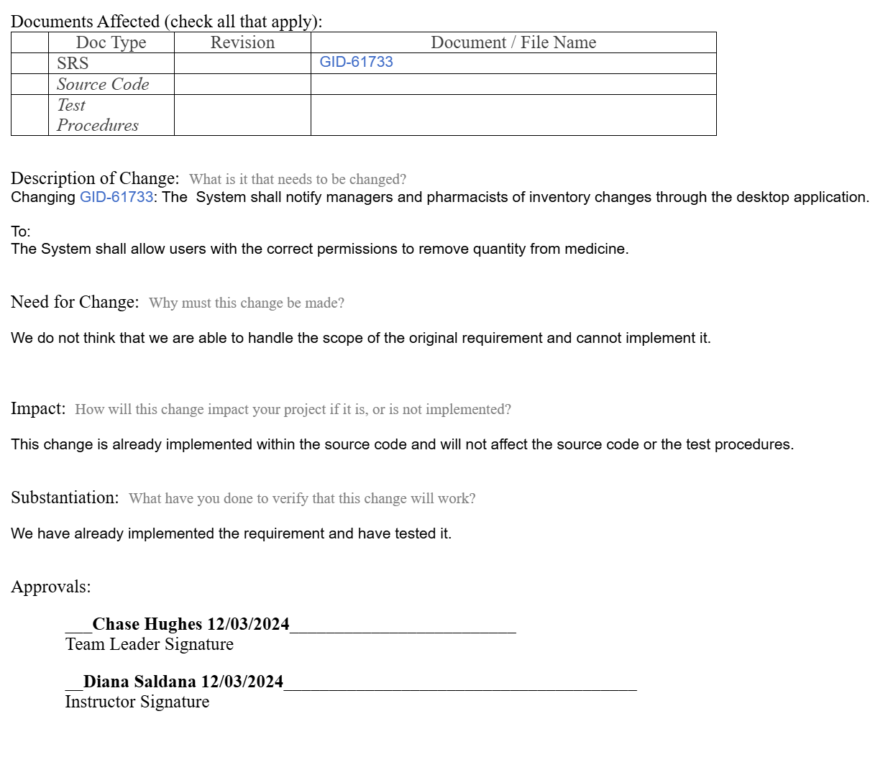
Desktop Notification Change Request
We changed this requirement that required the system to display a notification to the desktop if the inventory was changed. We do not have the technical know how or time to implement this correctly. Instead We changed this instead to a requirement that allows a user to remove a quantity

Slide 27
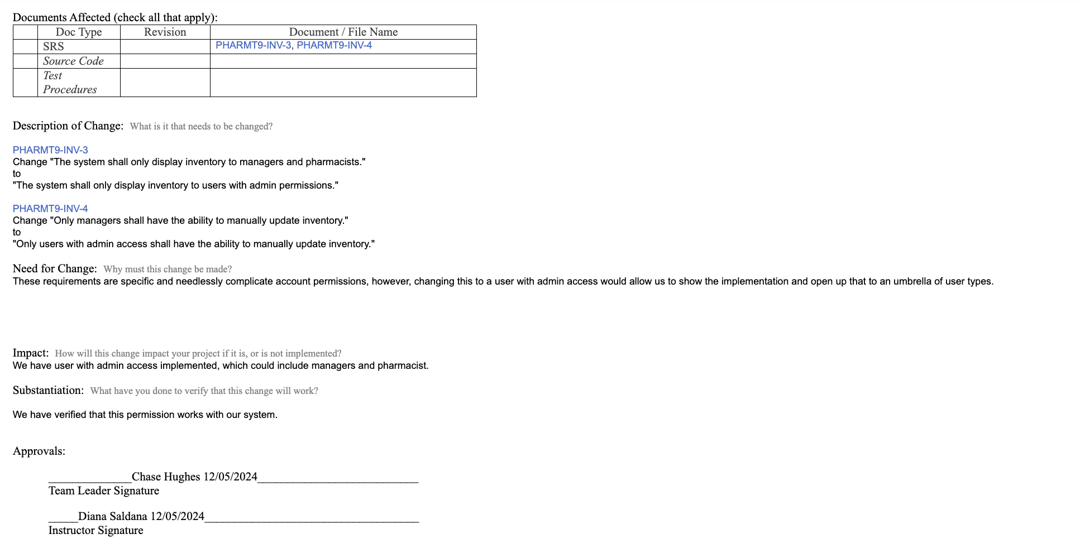
Permissions Change Request
We changed these requirements because we wanted to standardize the permissions within our system instead of having many different account types. Changing from specific to a user with admin access (ie pharmacist and manager).

Slide 28
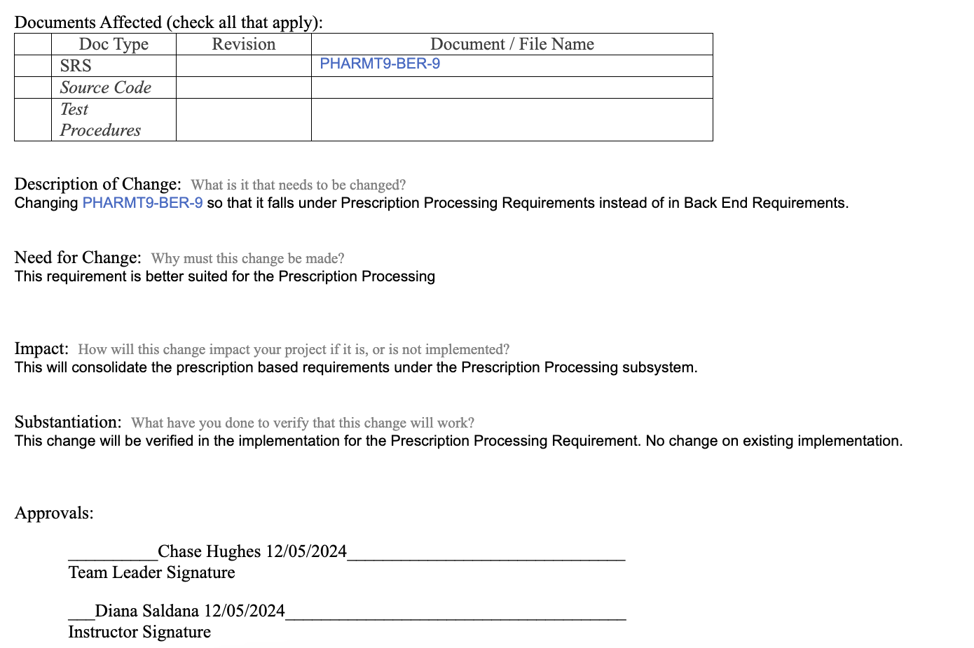
Move Requirement Change Request
We made this change request because we noticed that this requirement was better suited to be in the Prescription Processing Requirements than in Back End Requirements.

Slide 29
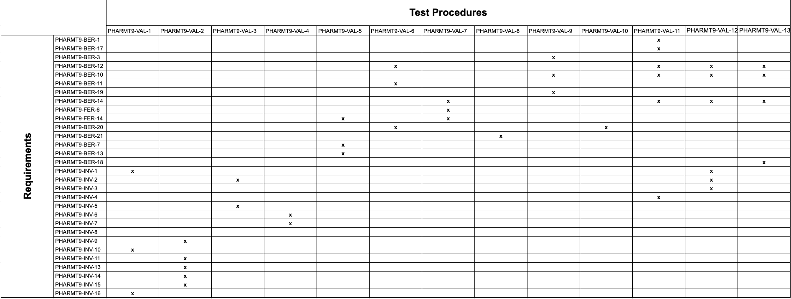
Requirement Mapping to Test Procedures

Slide 30
Test Environment Description
Our test environment included the test files that we created on replit(IDE) when implementing the backend system and inventory control system.
For our Back End subsystem we create BESTest file that calls our backend functions and outputs error messages if the function return the wrong boolean value.
Test Case Drug , Aztec, used for our Test Procedures

Slide 31
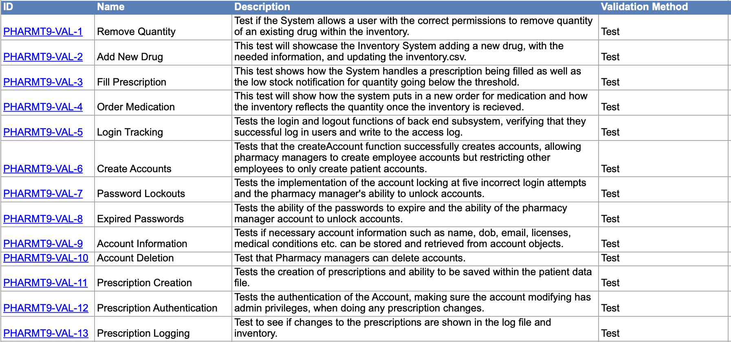
Test Procedures <and Results>
Export each individual Test Procedure from Jama.
Make sure that your test procedures are detailed and unambiguous
Two approaches to share results:
As you share each test procedure – show the results of executing that test at the same time you are showing the test procedure
The alternative to this is to summarize the results when you do the implementation demonstration.

Slide 32
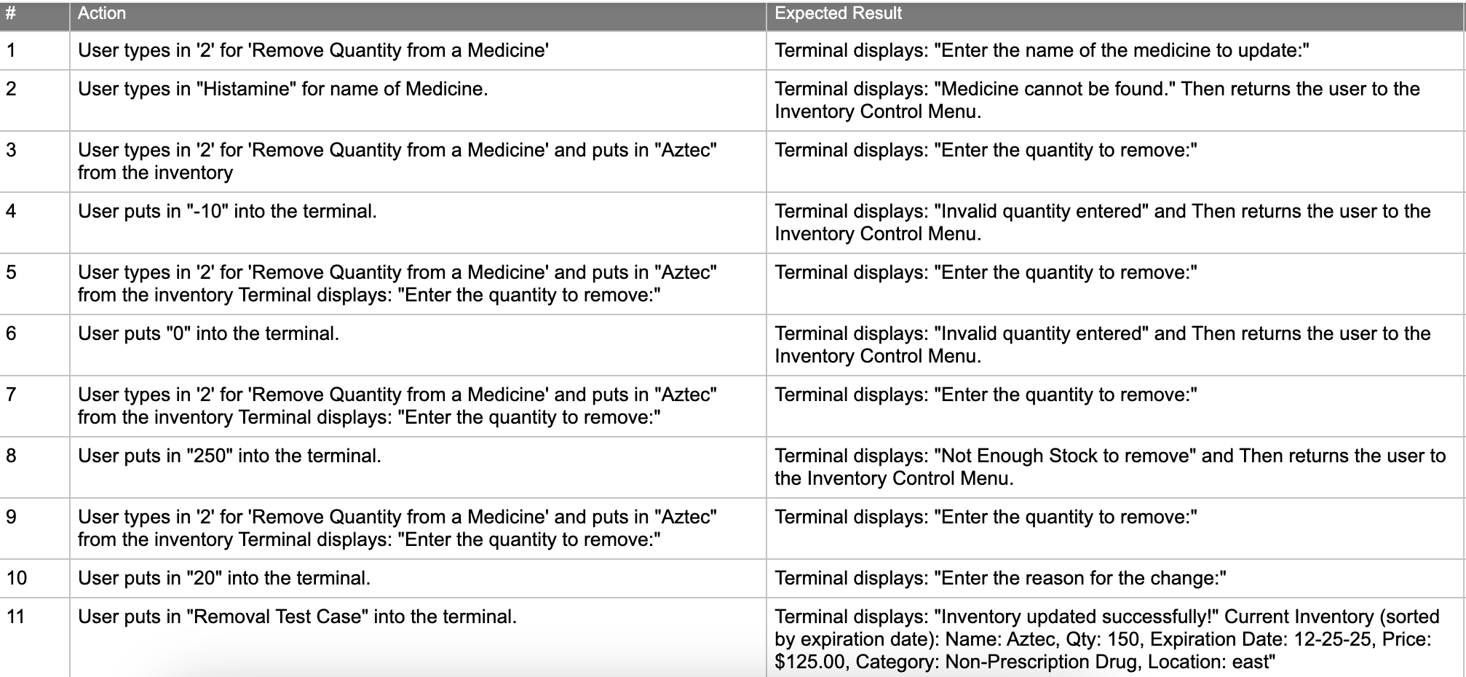
VAL-1 Remove Quantity

Slide 33
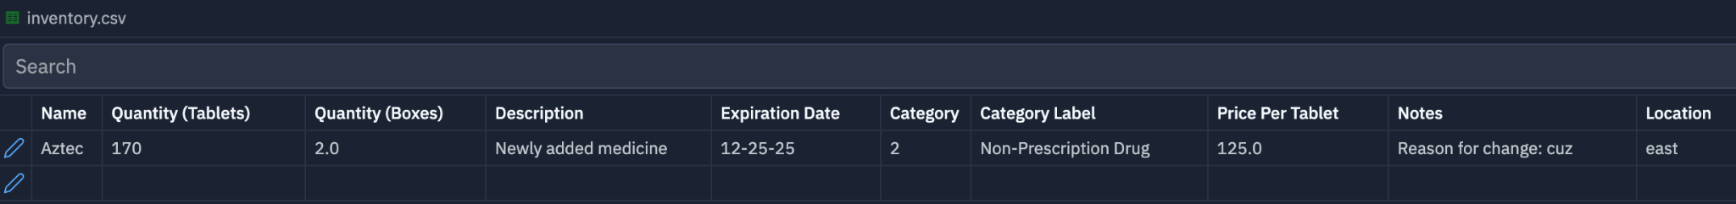
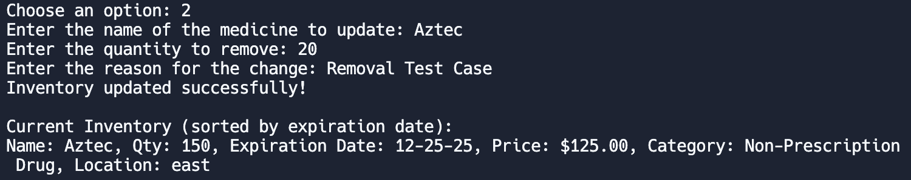
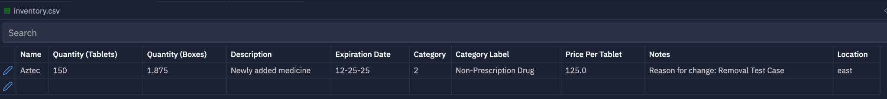
VAL-1 Remove Quantity (Normal Quantity)
inventory.csv before VAL-1
Terminal
inventory.csv after VAL-1
PASSED
Produced the correct results.
Successfully removed 20 tablets from the inventory for the test case drug, Aztec.

Slide 34
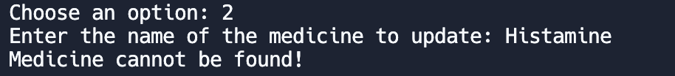
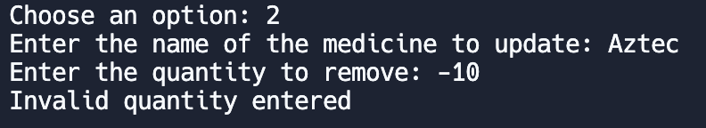
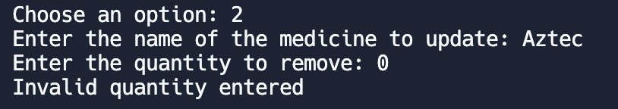
VAL-1 Remove Quantity (Abnormal Quantity)
PASSED
Produced the correct results.
Successfully displayed error message, “Medicine cannot be found” when wrong medicine entered.
Successfully displayed error message, “Invalid quantity entered” when 0 or negative number entered.

Slide 35
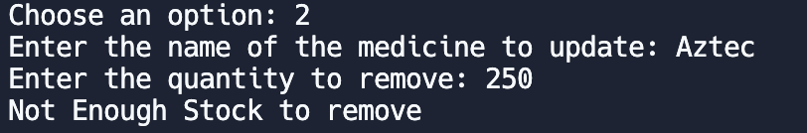
VAL-1 Remove Quantity (Excessive Quantity)
PASSED
Successfully displayed “Not Enough Stock to remove” when an amount is input more than amount that is in inventory.

Slide 36
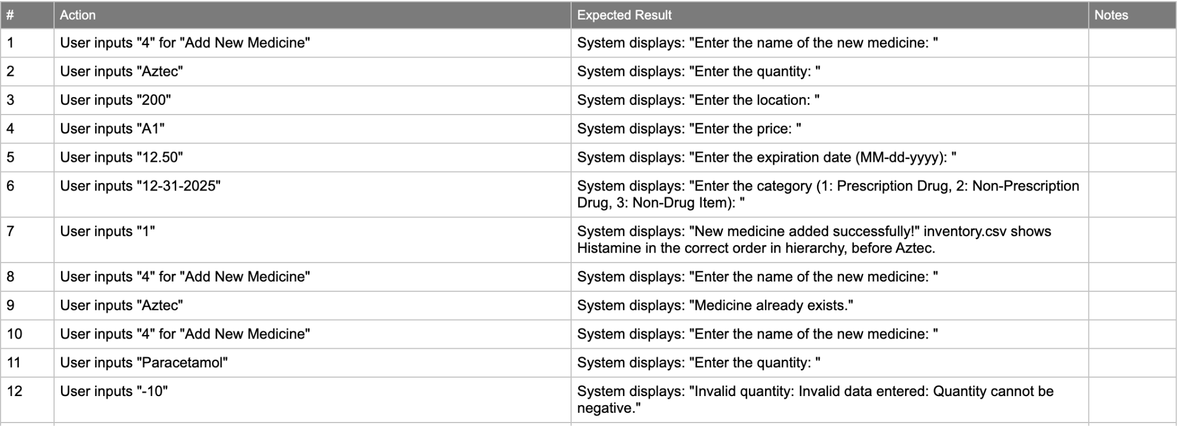
VAL-2 Add New Drug

Slide 37
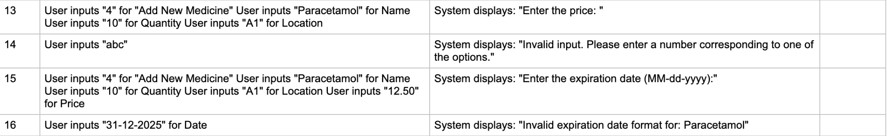
VAL-2 Add New Drug (Continued)

Slide 38
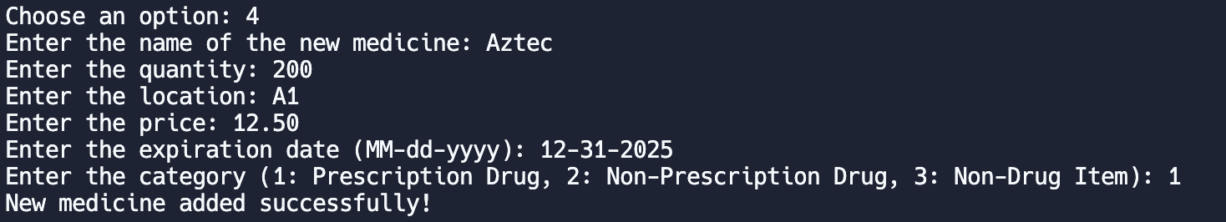
VAL-2 Add New Drug (Normal Case)
PASSED
inventory.csv before VAL-2
Terminal
inventory.csv after VAL-2
Produced the correct results
Successfully added a new drug, Aztec, inserting it into the correct place in the inventory.

Slide 39
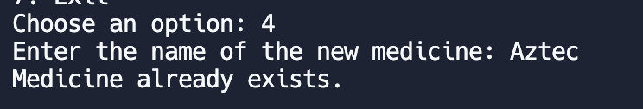
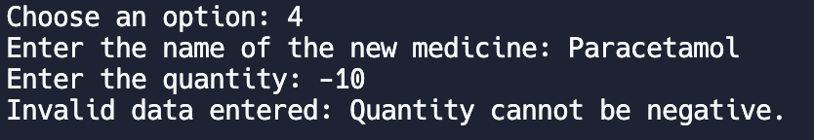
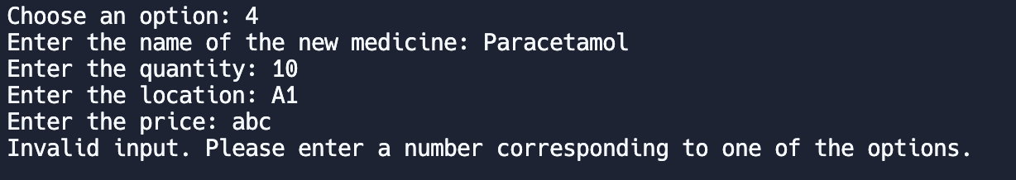
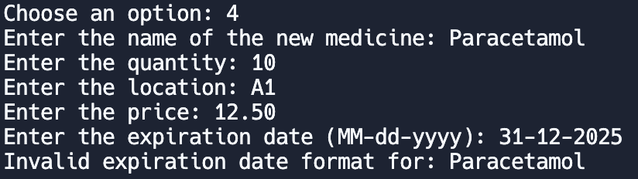
VAL-2 Add New Drug (Abnormal Cases)
PASSED
Successfully identified that the drug already existed and stopped the new order.
Displayed error when a negative value was input
Displayed error when price was not a double
Displayed error when date format was incorrect

Slide 40
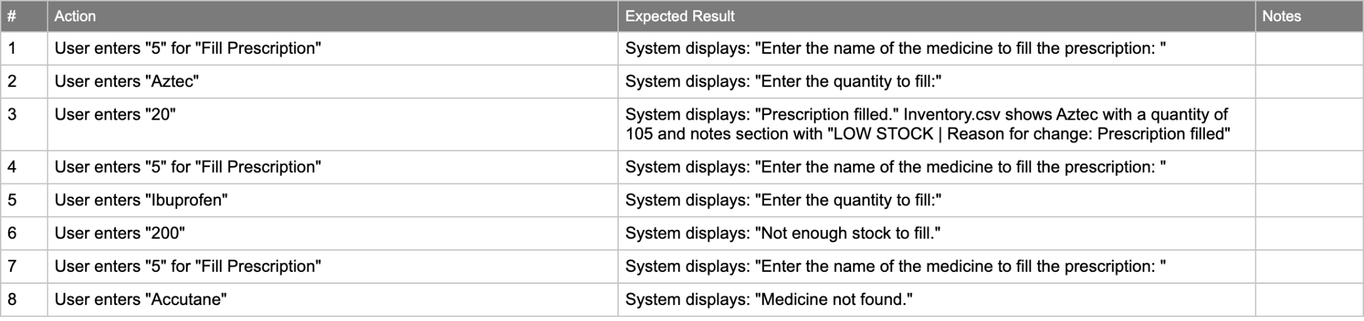
VAL-3 Fill Prescription

Slide 41
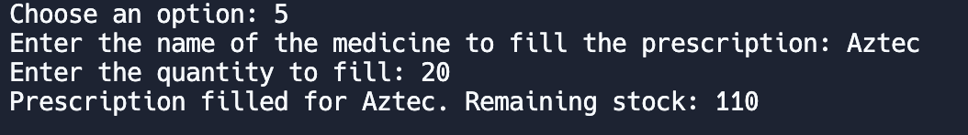
VAL-3 Fill Prescription (Normal Case)
inventory.csv before VAL-3
Terminal
inventory.csv after VAL-3
PASSED
Produced the correct results
Correctly filled a prescription, reducing the quantity, updating the reasoning, and displaying LOW STOCK notification for this drug.

Slide 42
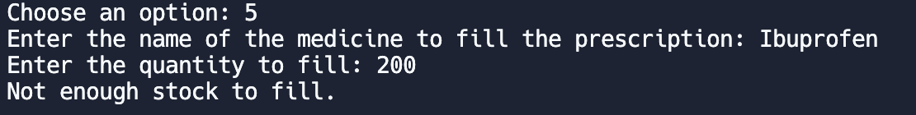
VAL-3 Fill Prescription (Normal Case)
PASSED
Successfully displays error message when prescription is larger than quantity within the inventory.
Successfully displays error when prescription called for drug that is not within the inventory.

Slide 43
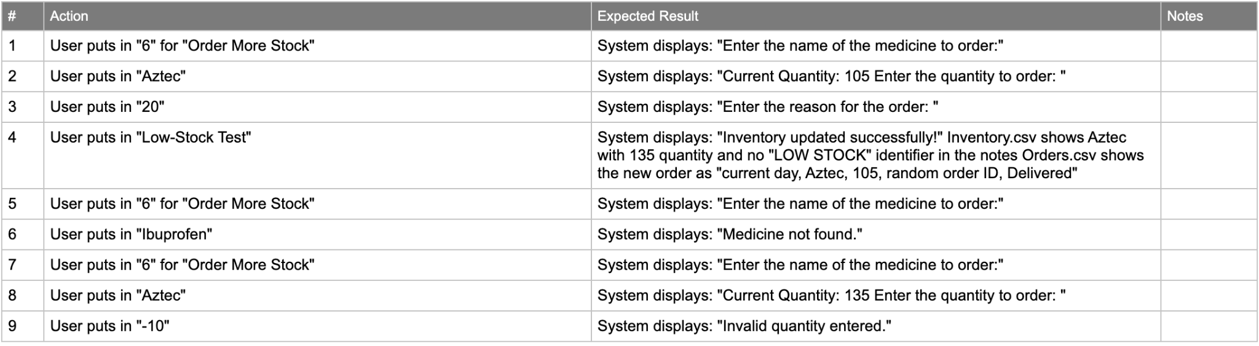
VAL-4 Order Medication

Slide 44
VAL-4 Order Medication (Normal Case)
PASSED
Produced the correct results
Correctly added the amount ordered to the drug, Aztec, updating the drug in the inventory.csv and removing the LOW STOCK notifier. As well as updating the orders.csv with a new order.

Slide 45
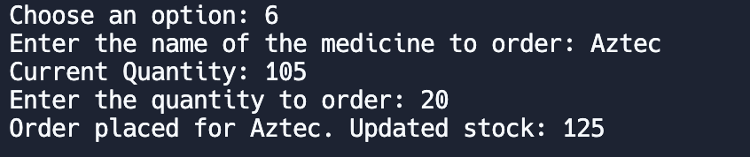
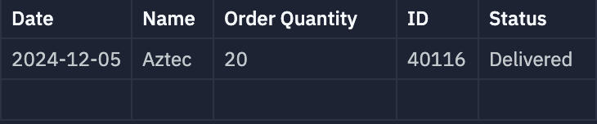
VAL-4 Order Medication (Normal Case)
Inventory.csv before VAL-4
Terminal
Inventory.csv after VAL-4
Orders.csv

Slide 46
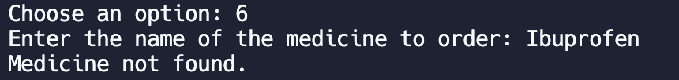
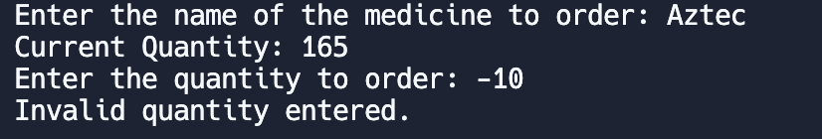
VAL-4 Order Medication (Abormal Cases)
PASSED
Successfully displays error when user tries to order more stock for a drug not in inventory.
Successfully displays error if user tries to order a negative quantity.

Slide 47
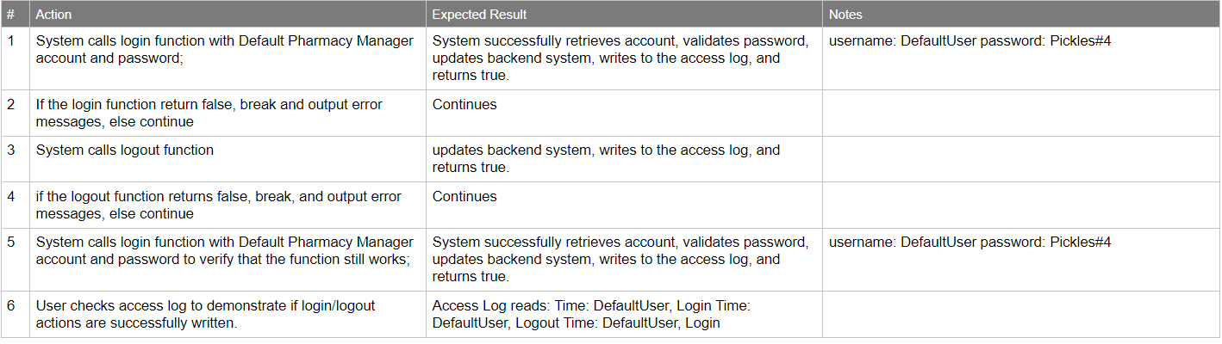
VAL-5 Login Tracking

Slide 48



VAL-5 Login Tracking
PASSED
None of the three branches throw an error since the functions return right results
access verified through log.csv access log file.
Program runs to end

Slide 49

VAL-6 Create Accounts

Slide 50

VAL-6 Create Accounts
PASSED
None of the three branches throw an error since the functions return right results
Pharmacy Manager successfully creates employee account.
Cashier cannot create employee account but can create patient account
Program runs to end

Slide 51

VAL-7 Password Lockouts

Slide 52


VAL-7 Password Lockouts
PASSED
Users cannot login with incorrect password
Successfully track failed attempts and locks accounts upon 5 incorrect logins
Pharmacy Managers can unlock accounts

Slide 53

VAL-8 Expired Passwords

Slide 54

VAL-8 Expired Passwords
PASSED
Users unable to log in with expired password.
Pharmacy Manager successfully unlocks account, allowing the user to login.

Slide 55

VAL-9 Account Information

Slide 56

VAL-9 Account Information
PASSED
Accounts successfully store and display personal information.
Pharmacy Manager successfully modified account information
Non-Pharmacy Manager failed to modify employee account information.

Slide 57

VAL-10 Account Deletion

Slide 58

VAL-10 Account Deletion
PASSED
Successfully removed accounts from hashmap / database
Accounts successfully deleted by Pharmacy Manager
Accounts cannot be deleted by other employee

Slide 59

Val-11 Prescription Creation

Slide 60


Val-11 Prescription Creation
Passed
Successfully added prescription to account patient
Account Added to patient data csv
Invalid medication in inventory does not create Rx object

Slide 61

Val-12 Prescription Authentication

Slide 62


Val-12 Prescription Fill Authentication
Passed
Authentication for admin user succeeds in filling prescription authentication
Patient login successfully fails to create new prescription

Slide 63

Val-13 Prescription Logging

Slide 64



Val-13 Prescription Logging
Passed
Admin User logs when changes are made to a prescription object.
Albuterol inventory amt changes when filled

Slide 65
Code Demonstration / Test Results
BackEnd and Inventory control subsystems implementation

Slide 66
Test Anomalies
We have no test anomalies or failures for the Back End Subsystem and Inventory Subsystem for Pharmacy.

Slide 67

Summary of Waivers
Requirement: PHARMT9-INV-8 Expired Medication Notification
"The System shall generate alerts for pharmacy managers at least 30 days before medicine expiration date."
Reasoning:
The alert functionality requires integration with multiple data sources and notification systems that we are unable to implement. We do not have the technical know-how to put in APIs and other systems for sending notifications to desktops.

Slide 68

Summary of Waivers
Requirement: PHARMT9-BER-18 Access Change Information
“Access logs shall store data such as prescription and amount changed.”
Reasoning:
Cannot be implemented with prescription/report subsystems. Additionally the requirement is incoherent because access logs should only contain information about when and who logs in and logs out of the system.

Slide 69

Overall Evaluation of Test Results

Slide 70

Overall Evaluation of Test Results

Slide 71

Overall Evaluation of Test Results

Slide 72

Overall Evaluation of Test Results

Slide 73

Overall Evaluation of Test Results

Slide 74

Overall Evaluation of Test Results

Slide 75

Overall Evaluation of Test Results

Slide 76

Overall Evaluation of Test Results

Slide 77

Overall Evaluation of Test Results

Slide 78
Exit Criteria
All requirements allocated to current release have been tested
All test cases have been executed and passed
Software system working as required
All actions items are closed
open with pending action deferred to possible future release
No high priority defect in the product
Risk in project is under acceptable limit

